Slide 1
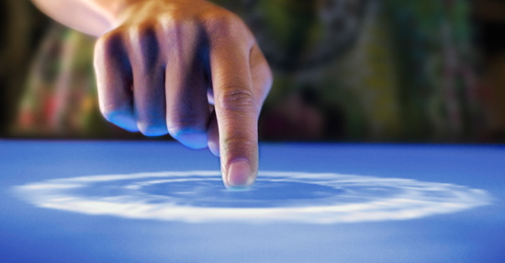
MULTITOUCH POLYGON MORPHING

Slide 2
HARDWARE SPECIFICATION
Processor : Core 2 Duo 2.0Ghz
Ram : 2 GB
Hard Disk : 15 GB
Input device : Standard Input device
Output device : Monitor or Multitouch enabled Surface Table

Slide 3
INTRODUCTION TO MULTITOUCH HARDWARE
Multi-touch (or multitouch) denotes a set of interaction techniques that allow computer users to control graphical applications with several fingers.
Multi-touch devices consist of a touch screen (e.g., computer display, table, wall) or touchpad, as well as software that recognizes multiple simultaneous touch points, as opposed to the standard touchscreen (e.g. computer touchpad, ATM), which recognizes only one touch point.

Slide 4
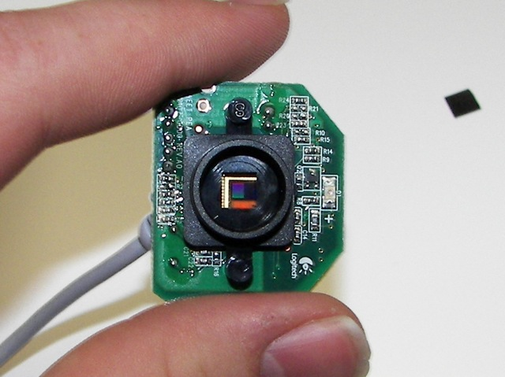
VISIBLE LIGHT SENSOR

Slide 5
MATERIALS NEEDED
Acrylic Glass
Webcam - It requires a few modifications by removing the IR filter used to block detection of infrared lights.
Projector
Wood frame
IR Led - commonly used in remote controls such as the one you have on your TV
Resistor
Power Source - 12V power supply

Slide 6
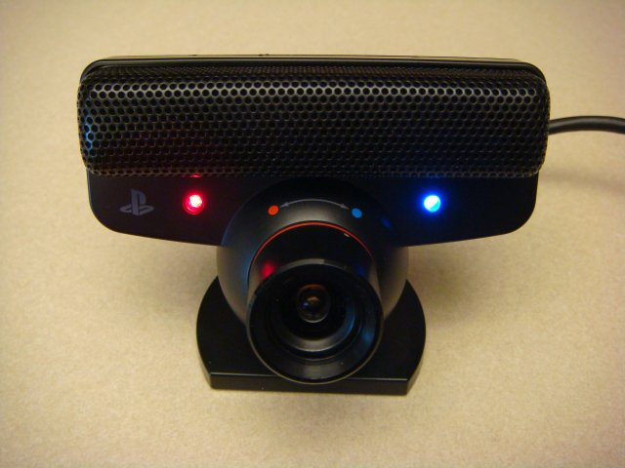
PLAY STATION EYE CAMERA

Slide 7
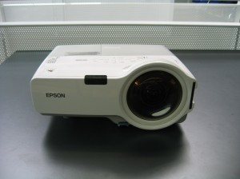
PROJECTOR

Slide 8
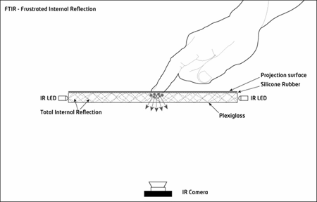
METHOD
Frustrated Total Internal Reflection (FTIR)

Slide 9
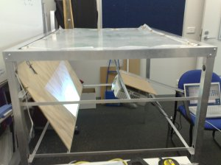

Slide 10
Thank you

